Slide 1

Data risk in the age of digital
A discussion on the privacy angle and future careers
Amit Mishra
5th January, 2019

Slide 2

Agenda
The privacy debate
Where to draw the line?
The digital angle
Discussing digital risk
Conclusion

Slide 3
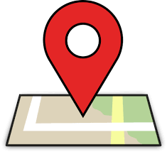

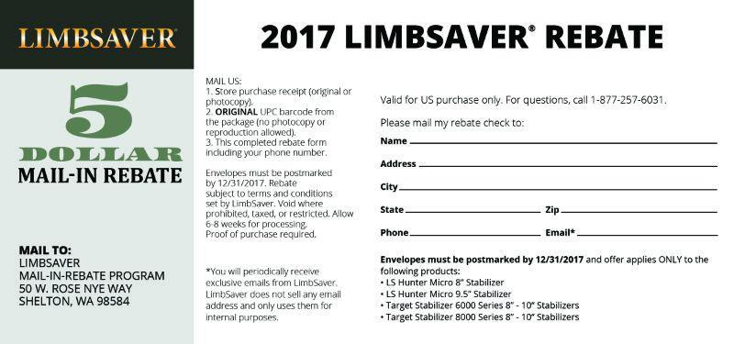
A curious case of missing Sox How your data found it’s way in the enterprise?
Age of Empires
Have complete control over my life
Google, where is my blue Sox?
Controls your belief system
Age of Surveillance
How did google know about it?
Spooky and outrageous
Age of Social media analytics
You liked Steve’s Sox?
Self inflicted damage
Age of Innocence
Voluntary data sharing
Irritant
$5 just for sharing my postal address?
My life is an open book
I know you need a black sox as well
Complete surrender

Slide 4


It is the data that is driving today’s world But what about the outcome?

Slide 5
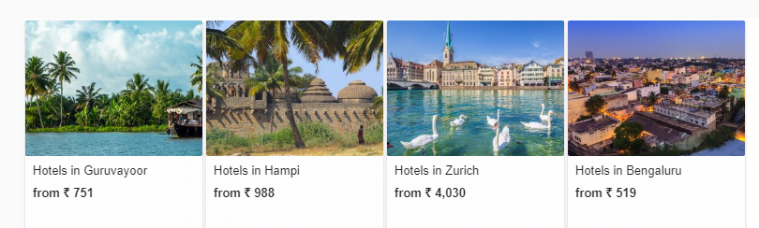
Data drives today’s business A case in favor of enterprises
Cost optimization
Customer Experience
Targeted marketing
Product Design
But are the customer pleased with such experience?

Slide 6

It is drawing the battle lines between enterprises and the rest of the world

Slide 7
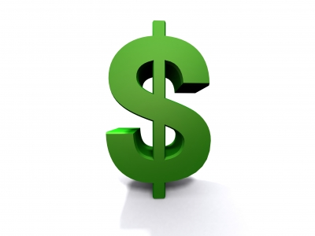
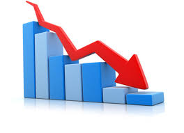
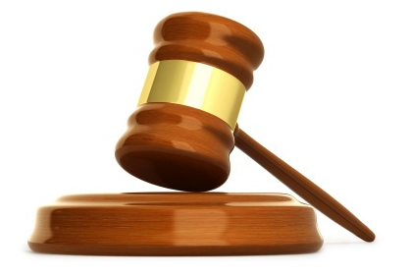
Is the data security a concern only for the individuals, not the enterprises?
Loss of business
Litigation
Cost of recovery

Slide 8
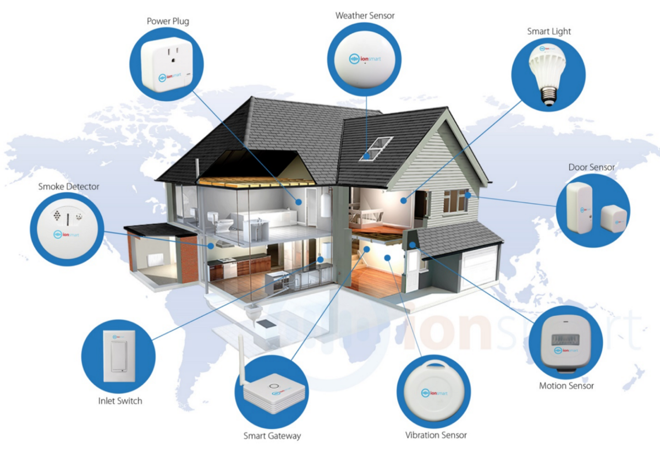
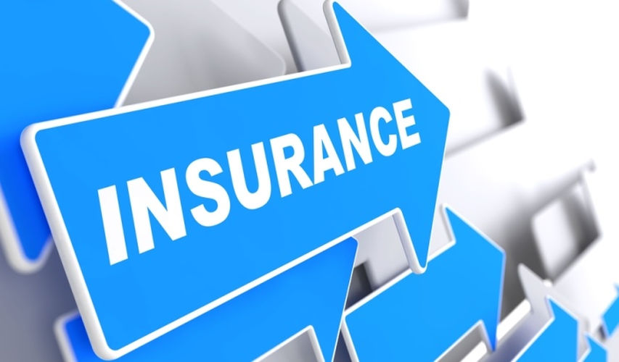
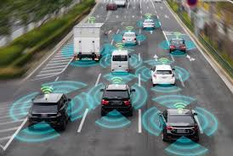

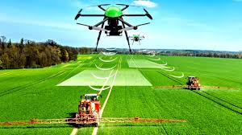
Just about when you thought we know how to fix this…… Dawn of a new era – led by Digital everything

Slide 9

And the fallout of digital…
Move from IT risk to personal health and safety risk
Collapsed network boundaries – where do I put my firewall?
Which data is being collected and shared?
Can I trust this?

Slide 10
Why should you pay attention to any of these?
Because breach of privacy and digital risk brings about few questions related to…
Which opens new career choices…
Digital Ethics
Digital Activists
Morality
Legal
Advisors, security consultants, solution architects, risk and compliance professionals etc
Customer trust

Slide 11
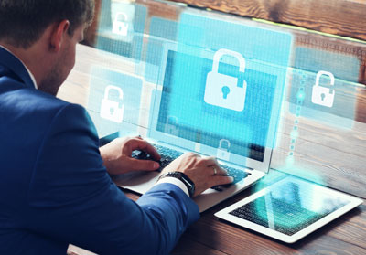
Be the white knight – be the data privacy/protection officer
A day in the life of an information security professional
Keep a tab on regulatory and sensitive data usage and sharing in the enterprise
Give a view to the higher management on the state of compliances and risk
Build, evolve and maintain the plan to protect the data that is relevant to new age threats
Be informed about the ongoing incidents and be part of the remediation programs

Slide 12
Thank you
www.linkedin.com/in/amit-mishra-9453393

